Slide 1

MYSURU ROYAL INSTITUTE OF TECHNOLOGY, MANDYA
Mini Project
On
Virtual Assistant
Under the guidance of Presented By
SEEMA FIRDOS BHUMIKA.V[4MU22CS005]
Assistant Professor CHANDANA.B[4MU22CS009]
Dept.of CSE KEERTHANA.M[4MU22CS030]
KEERTHANA.M[4MU22CS031]

Slide 2
CONTENTS
Introduction
Literature review
Objectives
Proposed Methodology
Software and Hardware Description
Advantages and Disadvantages
Partial Output
References

Slide 3
INTRODUCTION
Virtual assistant chatbots, utilizing AI and NLP, facilitate humanlike conversations
have applications across various industries
improving service quality and user experience.
As AI advances, chatbots are becoming more dynamic and integral to daily digital interactions
offering 24/7 accessibility and personalized responses.

Slide 4
LITERATURE REVIEW
Recent Advances:
Improved AI and NLP algorithms allow chatbots to handle complex conversations more effectively (Smith et al., 2023).
Machine learning helps chatbots learn from user interactions, enhancing performance (Doe et al., 2022).
Agent based chatbots provide personalized assistance in education, health care and finance (Kumar et al., 2022).

Slide 5
Challenges:
Limited ability to personalize interactions can lead to unsatisfactory user experiences
(Johnson et al., 2021).
Integrating chatbots with existing systems requires strong APIs and interoperability standards
(Lee et al., 2020).
Future Directions:
Improving chatbots' personalization and contextual understanding is essential for more
human-like engagements.
Addressing data privacy and security concerns is crucial for building user trust and broader
acceptance of chatbot technologies (Brown et al., 2023).

Slide 6
objectives
To develop a robust virtual assistant chatbot that interprets and responds to voice commands using natural language processing (NLP) techniques
To implement machine learning algorithms that enhance the chatbot’s ability to learn from user interactions and improve its performance over time
To design an intuitive and interactive user interface that facilitates easy access to the chatbot’s features for task automation and real-time assistance

Slide 7
Proposed methodology
Requirement Analysis
1. user interaction scenarios,
2.task definition
3.platform identification
System Design and Architecture
1.modular architecture
Implementation
1.fron-tend
2.speech recognition
Training the Chatbot
1.training data collection
Testing and Evaluation
1.unit testing
2.integration testing
3.user testing

Slide 8
Software and hardware description
Hardware requirements:
4 GB RAM
Proper Internet Connection
cloud-based infrastructure
Software requirements:
Programming Languages: HTML, CSS and JavaScript
Speech synthesis and recognition API
Hosting and deployment

Slide 9
ADVANTAGES
24/7 Availability: They can provide assistance at any time, improving user convenience.
Efficiency: Chatbots handle multiple interactions simultaneously, reducing wait times.
Consistency: They deliver uniform responses, ensuring service quality.
Cost-Effective: Reduces the need for a large support team, saving costs.
Data Collection: Gathers valuable user data for insights and improvements.
Personalization: Offers tailored responses based on user data.
Scalability: Easily handles increased interaction volumes.
Instant Response: Provides immediate answers to user queries.
Global Reach: Serves users across different time zones without extra staffing.

Slide 10
DISADVANTAGES
Limited Understanding: Struggles with complex or nuanced queries.
Lack of Empathy: Misses the human touch needed for certain interactions.
Maintenance: Requires regular updates and technical maintenance.
Privacy Concerns: Handling sensitive data requires robust security measures.
User Reluctance: Some users prefer human interaction over chatbots.

Slide 11
PARTIAL OUTPUT
The virtual assistant chatbot "Shifra" is expected to provide an efficient and interactive platform for users to perform tasks through voice commands.
It will allow users to open web applications like YouTube, Google, and social media platforms, as well as perform basic tasks like checking the time and date.

Slide 12
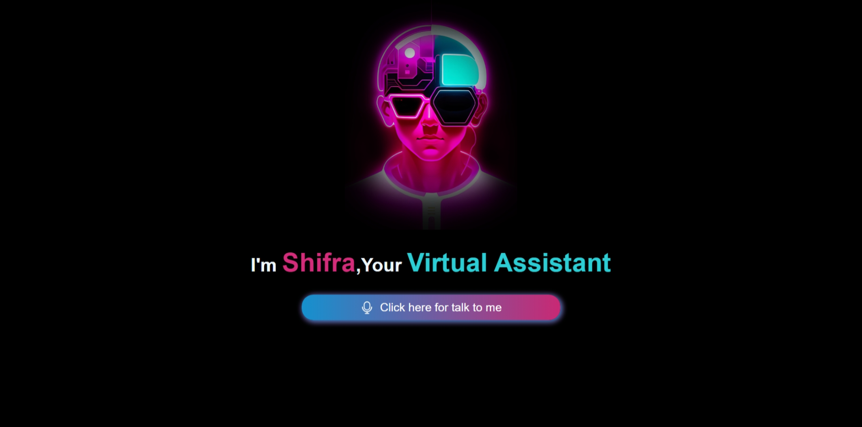

Slide 13
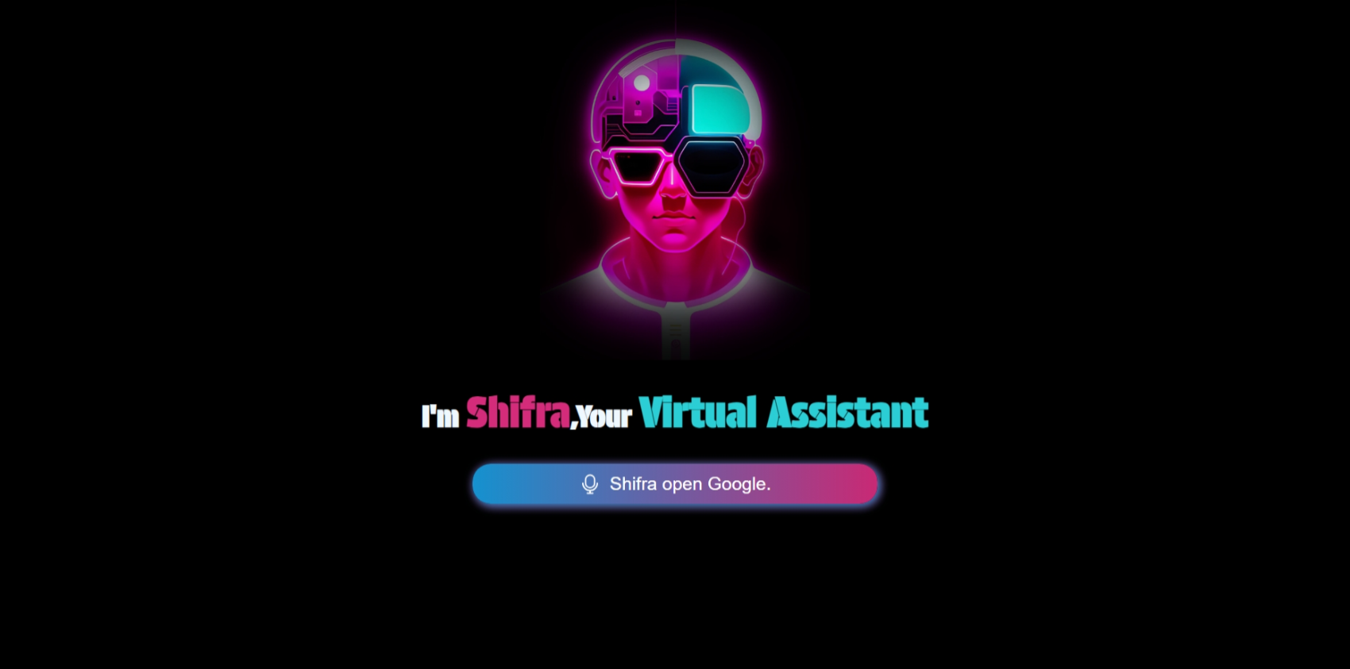

Slide 14
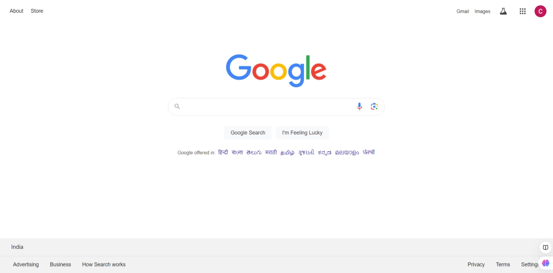

Slide 15
REFERENCES
J.Smith, A. Johnson, and M. Williams, “Deep Learning Techniques for Virtual Assistants," in Advances in AI and Machine Learning Applications, A. Roberts, Ed. New York, NY: Springer, pp. 45-67, 2019.
"Building a Virtual Assistant Chatbot with AI," YouTube, uploaded by Code with Harry, https://youtu.be/C4LBV38aqb0, accessed October 9, 2024.

Slide 16


